Slide 1
Neural Network Lab
GROUP D:
Cristian Ruiz Martín Ignacy Borzestowski Pablo Rubia Arias Mikolaj Zabski

Slide 2
Main Task: Creating the Training and Validation Sets I
First we create the training and validation by calling the generateDataSet() method.
DataSet trainingSet = generateDataSet();
DataSet validationSet = generateDataSet();
We generate the data at random with the following helper method:
private static DataSet generateDataSet() {
DataSet dataSet = new DataSet(2, 1);
Random random = new Random();
for (int i = 0; i < NeurophExampleMain.SAMPLES; i++) {
double x = (random.nextDouble() * 2 * Math.PI) - Math.PI;
double y = (random.nextDouble() * 2 * Math.PI) - Math.PI;
double f = Math.sin(x) * Math.cos(y);
dataSet.add(new DataSetRow(new double[]{x, y}, new double[]{f}));
}
return dataSet;
}

Slide 3
Main Task: Creating the Training and Validation Sets II
Then we set up the neural network as a MultiLayerPerceptron with 5 layers. We tried increasing and decreasing the number of layers, but we found that 5 layers have given us the best results.
Given the function we need to imitate (F(x,y) = sin(x) * cos(y)), we found that the hyperbolic tangent transfer function was the best fitting.
MultiLayerPerceptron neuralNetwork = new MultiLayerPerceptron(TransferFunctionType.TANH, 2, 5, 7, 5, 1);
Through trial and error we observed the best results occurred when keeping the numbers of neurons below 10.
We also set up the learning rate and limited max iterations to one.
After testing we ended up choosing 0.02 as the best learning rate with this number of epochs and neural network.
neuralNetwork.getLearningRule().setLearningRate(0.02);
We set max iterations to 1 so the learning is not iterative and is instead done with epochs.
neuralNetwork.getLearningRule().setMaxIterations(1);

Slide 4
Main Task: Training the Model
Then we proceed to training the model on the training set
learn() method is used to train the neural network with the training set.
It does a learning epoch each time it is called.
Training error is the difference of the output of the neural network with the desired output of the training set.
Validation error is the difference of the output of the neural network with the desired output of the validation set.
for (int i = 1; i <= NUM_EPOCHS; i++) {
neuralNetwork.getLearningRule().learn(trainingSet);
double trainingError = calculateMeanSquaredError(neuralNetwork, trainingSet);
double validationError = calculateMeanSquaredError(neuralNetwork, validationSet);
System.out.printf("Epoch: %d, Training Error: %.5f, Validation Error: %.5f\n", i, trainingError, validationError);
}

Slide 5
Main Task: Checking validation and test error I
As we have seen in the code of the previous slide, we call the function calculateMeanSquaredError, which is defined like this:
private static double calculateMeanSquaredError(NeuralNetwork<?> neuralNetwork, DataSet dataSet) {
double mse = 0.0;
for (DataSetRow row : dataSet) {
neuralNetwork.setInput(row.getInput());
neuralNetwork.calculate();
double[] networkOutput = neuralNetwork.getOutput();
double output = row.getDesiredOutput()[0];
double diff = output - networkOutput[0];
mse += diff * diff;
}
return mse / dataSet.size();
}

Slide 6
Main Task: Checking validation and test error II
After analyzing the results found in output.txt, we can see that both the validation and test error diminish in each epoch, meaning that the model is getting more accurate.
We should be careful however, since an overfitting would make it so the test error keeps going down but the validation error increases, meaning that the model is starting to fit the test sample provided rather than the function itself, so we should stop doing epochs before that point.
Also, we should stop when the decrement in error is insignificant, since it will make the model train for a longer time just for a difference that is not noticeable at all.
Considering all this, we have decided that 1000 epochs provide a pretty good result. This number would need to be different if we changed the number of hidden neurons in each layer or the training rate.

Slide 7
Main Task: Generating uniform test samples
private static final int GRID_SIZE = 100;
private static final double SPACE = 2 * Math.PI / GRID_SIZE;
Given this, we fill the grid with 10000 evenly spaced points.
private static DataSet generateTestSamples() {
DataSet dataSet = new DataSet(2, 1);
for (int i = 0; i < NeurophExampleMain.GRID_SIZE; i++) {
for (int j = 0; j < NeurophExampleMain.GRID_SIZE; j++) {
double x = -Math.PI + i * SPACE;
double y = -Math.PI + j * SPACE;
double f = Math.sin(x) * Math.cos(y);
dataSet.add(new DataSetRow(new double[]{x, y}, new double[]{f}));
}
}
return dataSet;
}

Slide 8
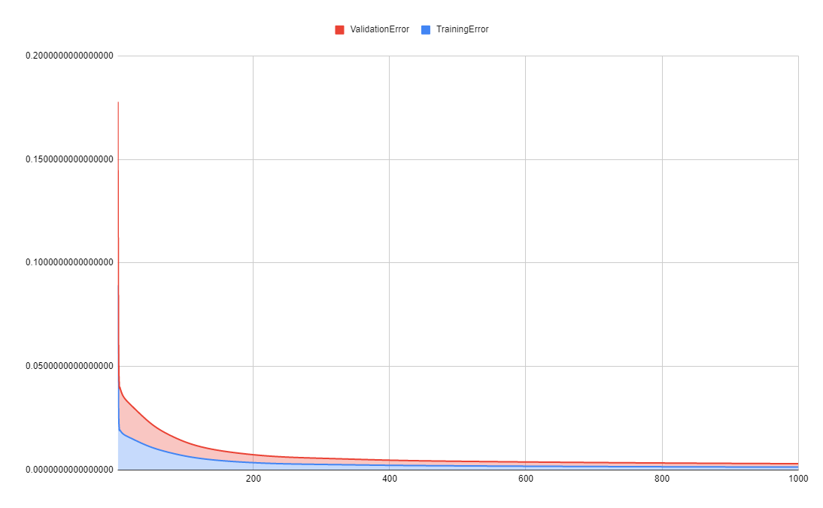
Optional Task: Comparing validation and test errors

Slide 9
Optional Task: Comparing validation and test errors II
We can see that the validation error starts off being way bigger than the test error, however the relation between the both of them seem to be similar for practically every epoch, except in the first ~10 epochs, where the validation error is around 0.175 and the test error is just below 0.05
It can also be observed that both follow a logarithmic decrease, where there is nearly no variation in the later epochs, if we continued doing epochs, after some point the validation error should start increasing even though the test error still decreases because of overfitting.

Slide 10
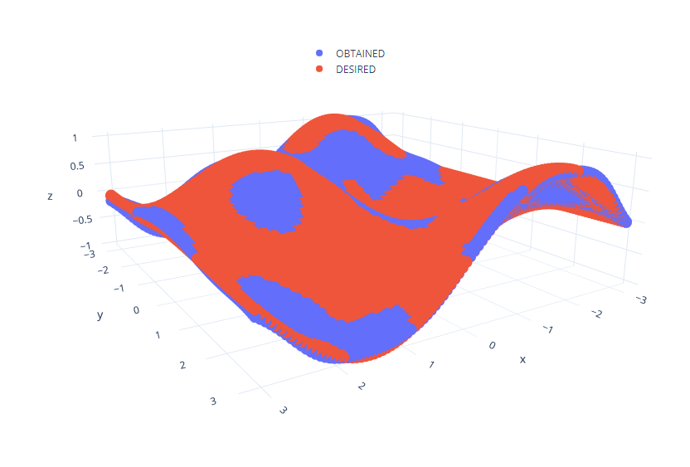
Optional Task: 3D figure comparing real and learned function I

Slide 11
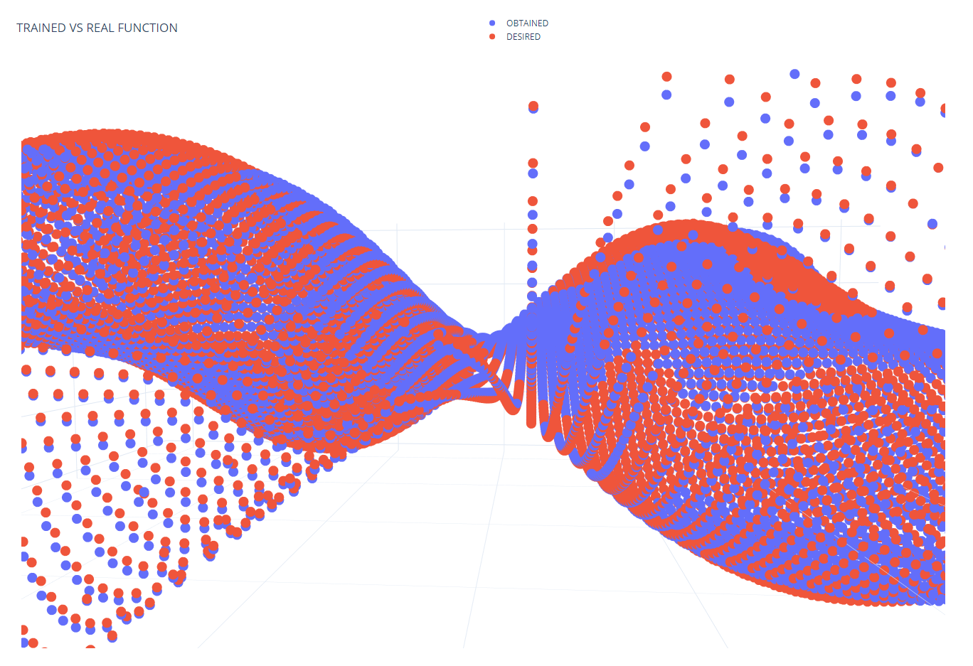
Optional Task: 3D figure comparing real and learned function II

Slide 12
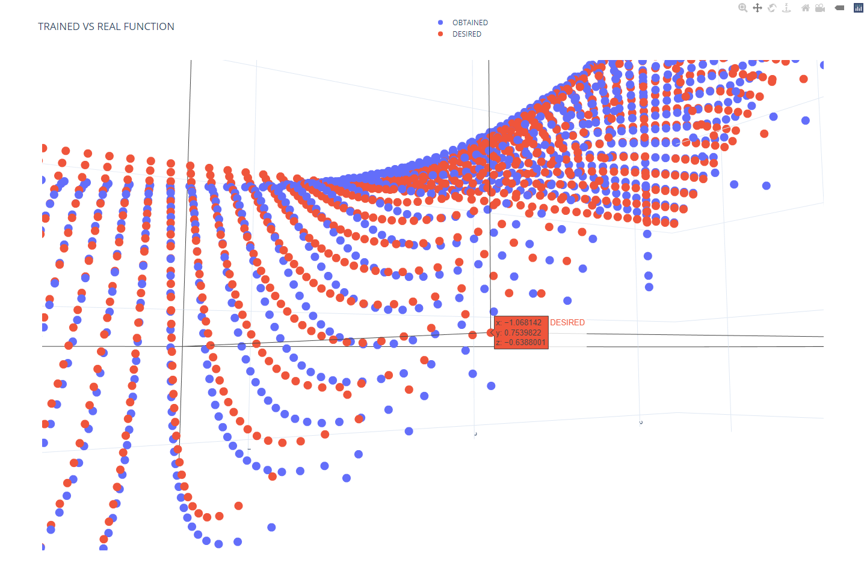
Optional Task: 3D figure comparing real and learned function III

Slide 13
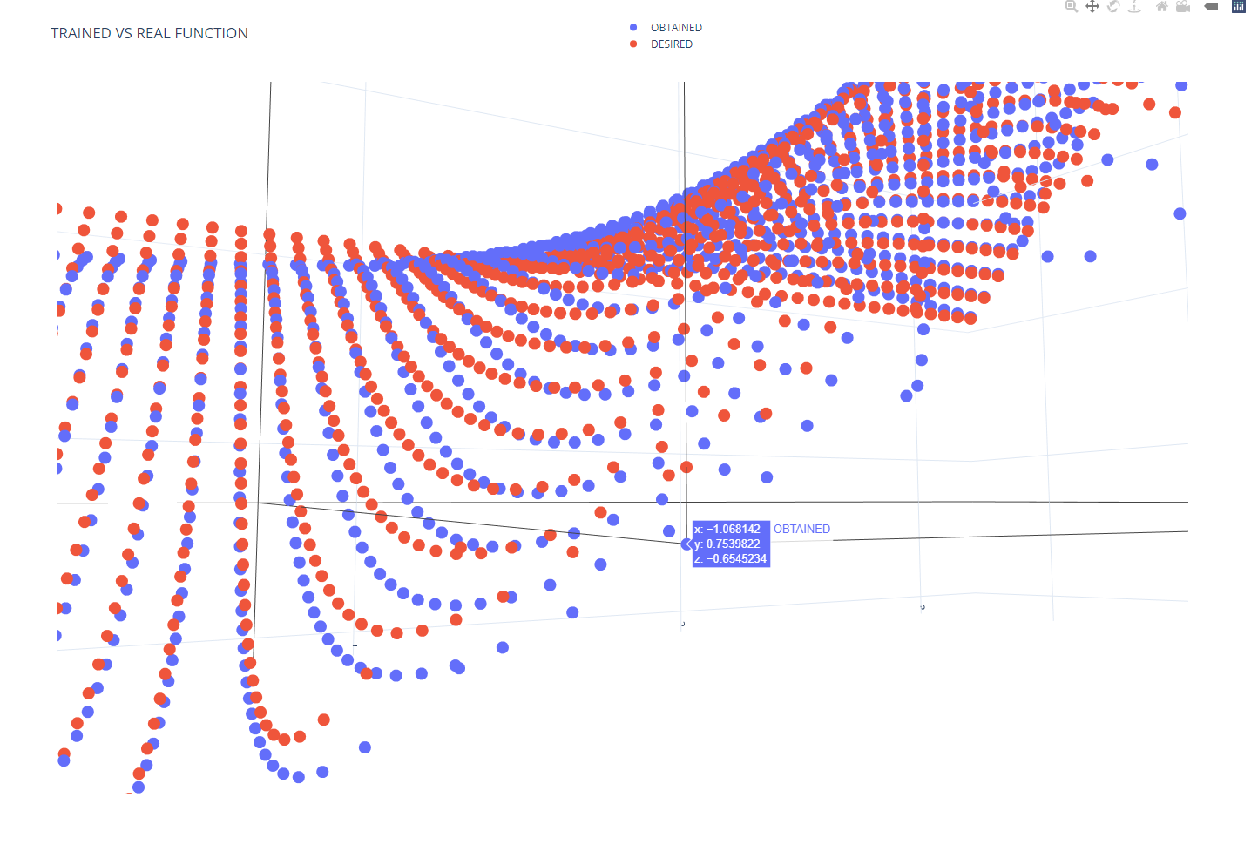
Optional Task: 3D figure comparing real and learned function IV

Slide 14
Optional Task: 3D figure comparing real and learned function V
We have generated a 3D figure with the output provided by the model when 100 x 100 points in a grid with range [-PI, PI] are passed as input, to compare it with their actual result.
The resulting error can be seen as the difference in height between both points.
After analyzing the errors, we can see that in some cases the result is practically the same in both desired and obtained outputs, and even though in some cases the difference may be a bit more noticeable if we zoom a lot, the overall error is pretty low, and that can be seen in the first picture where both surfaces are overlapping.

Slide 15
Conclusion:
After taking everything previously mentioned into account, we can conclude that with the parameters and values we have provided the generated model is pretty accurate and does not take too long to train.

